Slide 1


An Autonomous Institute
Affiliated to VTU, Belagavi,
Approved by AICTE, New Delhi,
Recognized by UGC with 2(f) & 12(B)
Accredited by NBA & NAAC
DEPARTMENT OF ELECTRONICS AND COMMUNICATION ENGINEERING
Subject Code : 18ECMP68
Mini-Project Name : VCD dependent Adaptive Traffic Control Signal
TEAM MEMBERS : Abhishek Janadri (1MJ18EC003)
Avinash Shivanand Kumbar (1MJ18EC018)
Ganapathi N A (1MJ18EC045)
Ganesh Babu R (1MJ18EC046)
An Autonomous Institution ,Affiliated to Visvesvaraya Technological University, Belagavi. Approved By AICTE, New Delhi. Recognized by UGC with 2(f) & 12(B) status. Accredited by NBA and NAAC.
1

Slide 2
Content
Abstract
Problem Statement
Solution
Why Digital Image Processing?
Algorithm
Block Diagram
Image Acquisition and RGB to Grayscale Conversion
Image Resizing and Image Enhancement
Edge Detection - Canny’s Edge Detection
Image Matching
Output Image
Conclusion

Slide 3
ABSTRACT
An Autonomous Institution ,Affiliated to Visvesvaraya Technological University, Belagavi. Approved By AICTE, New Delhi. Recognized by UGC with 2(f) & 12(B) status. Accredited by NBA and NAAC.
3

Slide 4
Abstract
With increased development in productivity of the Automobile Industry, The number of vehicles on roadway systems has / is gone higher , which as a result has led to traffic Congestion in almost all urbanized geography whose dire Consequence is rising significantly day by day. The intimate methodology to surmount the premise is to efficiently handle the departure period at the traffic junction.
Our team here proposes the effective handling of departure period based on application of Digital Image processing based Vehicle Congestive Density dependent Adaptive Traffic Control Signal.

Slide 5
PROBLEM STATEMENT
An Autonomous Institution ,Affiliated to Visvesvaraya Technological University, Belagavi. Approved By AICTE, New Delhi. Recognized by UGC with 2(f) & 12(B) status. Accredited by NBA and NAAC.
5

Slide 6
Problem Statement
In modern life we have to face with many problems one of which is traffic congestion becoming more serious day after day. It is said that the high tome of vehicles, the scanty infrastructure and the irrational distribution of the development are main reasons for augmented traffic jam. The major cause leading to traffic jam is the high number of vehicle which was caused by the population and the development of economy.
Currently, Manual Controlling and Automatic Controlling using Embedded Controllers are Employed at the Traffic Junction to manage the Vehicle Congestion. In the Manual Controlling system we need more man power. In contrary , automatic traffic management uses timer for every phase. Using electronic sensors is another way in order to detect vehicles, and produce signal that to this method the time is being wasted by a green light on an empty road. Traffic congestion also occurred while using the electronic sensors for controlling the traffic.
All these drawbacks are supposed to be eliminated by using Image processing based VCD Dependent Adaptive Traffic Control Signal

Slide 7
SOLUTION
An Autonomous Institution ,Affiliated to Visvesvaraya Technological University, Belagavi. Approved By AICTE, New Delhi. Recognized by UGC with 2(f) & 12(B) status. Accredited by NBA and NAAC.
7

Slide 8
Solution
Our group propose solution to the Problem Statement addressed by the Application of Image Processing.
The vehicles are detected by the system through images instead of using electronic sensors embedded in the pavement. A camera will be placed alongside the traffic light. It will capture image sequences.
Image processing is a better technique to control the state change of the traffic light. It shows that it can decrease the Vehicle congestion and avoid the time being wasted by a green light on an empty road.
It is also more reliable in estimating vehicle presence because it uses actual traffic images. It visualizes the practicality, so it functions much better than those systems that rely on the detection of the vehicles metal content.

Slide 9
WHY DIP?
An Autonomous Institution ,Affiliated to Visvesvaraya Technological University, Belagavi. Approved By AICTE, New Delhi. Recognized by UGC with 2(f) & 12(B) status. Accredited by NBA and NAAC.
9

Slide 10
Why Digital Image Processing?
Image Processing systems are becoming widely popular due to easy availability of powerful personnel computers, large memory devices, graphics softwares and many more.
In this project the operations that come under image processing are image enhancement operations such as sharpening, blurring, brightening, edge enhancement .Traffic density of lanes is calculated using image processing which is done of images of lanes that are captured using digital camera.
We have chosen image processing for calculation of traffic density as cameras are very much cheaper and in almost all urbanized locations Cameras are already installed at the traffic junctions than other devises such as sensors.

Slide 11
ALGORITHM
An Autonomous Institution ,Affiliated to Visvesvaraya Technological University, Belagavi. Approved By AICTE, New Delhi. Recognized by UGC with 2(f) & 12(B) status. Accredited by NBA and NAAC.
11

Slide 12
Algorithm
Reference Image
RGB to Gray
Image Resizing
Captured Image
RGB to Gray
Image Resizing
Image Enchancement
Edge Detection
Image Enchancement
Edge Detection
Image Matching
Time Allocation

Slide 13
Image Acquisition
Generally an image is a two-dimensional function f(x,y).The amplitude of image at any point say f(x1,y1) is called intensity of the image .
It is necessary that the image need to be in digital form to process it through digital computer. Each digital image composed of a finite elements and each finite element is called a pixel.
Image is acquired from the digital camera installed at the junction to process it .
RGB to Gray Scale Conversion
A single pixel in RGB requires 24 bit of storage while grayscale requires only 8 bits .Thus, 33% less memory is required to store grayscale image than to store an RGB image .
The execution time is thus reduced by converting an RGB image to a Gray Scale image.

Slide 14
Image Resizing/Scaling
It is the process of resizing a image from one pixel grid to another. Image resizing is necessary when you need to increase or decrease the total number of pixels.
In our Project Image Resizing is Important because ,Every Camera has its resolution, so when a system is designed for some camera specifications it will not run correctly for any other camera depending on specification similarities. so it is necessary to make the resolution constant for the specified application .
Image Enhancement
Image enhancement is the process of adjusting digital images so that the results are more suitable for display or further analysis , For instance eliminate noise, which will make it more easier to identify the key characteristics.
In poor contrast images, the adjacent characters merge during binarization. We have to reduce the spread of the characters before applying a threshold to the word image. Hence, we introduce “POWER- LAW TRANSFORMATION” which increases the contrast of the characters and helps in better segmentation.

Slide 15
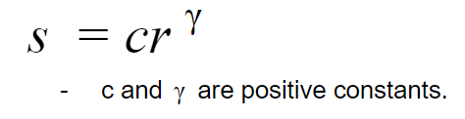
Image Enhancement Contd…
The basic form of power-law transformation also known as GAMMA CORRECTION is given by,
Here, S -> output intensity
r -> input intensity
In our project, γ = 0.9 .
If c is not equal to ’1’, then the dynamic range of the pixel value will be significantly affected by scaling. Thus, to avoid another stage of rescaling after power-law transformation, we fix the value of c = 1.
By Varying the gamma value changes the brightness of an image. Thus If the contrast of an image is predominantly low , there is a requirement of increasing the Intensity of Grayscale level.

Slide 16
Edge Detection
Edge detection is the name for a set of mathematical methods which aim at identifying points in a digital image at which the image brightness changes sharply or, more technically, has discontinuities or noise.
In our project we use “CANNY EDGE DETECTION TECHNIQUE” because of its various advantages over other edge detection techniques.
Canny Edge Detection Technique :
The Canny Edge Detector is one of the most commonly used image processing tools detecting edges in a very robust manner.
Canny edge detection technique is based on three basic objectives.
Low error rate.
Edge point are well localized.
Single edge point response .

Slide 17
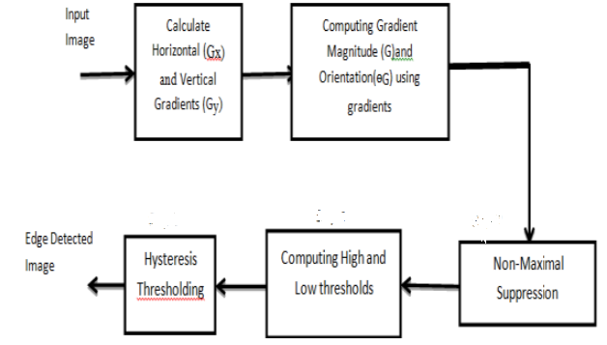
Canny Edge Detection Contd…`
The Canny Edge Detection Algorithm consist of the following basic steps
Smooth the input image with Gaussian filter.
Compute the gradient magnitude and angle images.
Apply non-maxima suppression to the gradient magnitude image.
Use double thresholding and connectivity analysis to detect and link edges

Slide 18





Canny Edge Detection Contd…
Let f(x,y) denote the input image and G(x,y) denote the Gaussian function:
We form a smoothed image, fs(x, y), by convolving G and f:
This operation is followed by computing the gradient and direction (angle) :
Where,
and
and

Slide 19
Canny’s Edge Detection Contd…
G(x , y ) is implemented using an n x n Gaussian mask and M(x, y) and G (x, y) are arrays of the same size as the image from which they are computed.
Because it is generated using the gradient M(x, y) typically contains wide ridges
The next step is to thin those ridges. The approach used her is “Non Maxima Suppression” the essence of this approach is to suppress the wide ridges . The result obtained is represented as g_{N}(x,y)
The final operation is to threshold g _{N}(x, y) to reduce false edge point. We do it by using a single threshold, in which all value below the threshold were set to 0.
If we set the threshold too low, there will still be some false edge (called false positives).
If the threshold is set too high, then actual valid edge points will be eliminated (false negatives).

Slide 20

Canny’s Edge Detection Contd…
We use two thresholds
A low threshold (TL) and
A high threshold (TH).
Canny suggested that the ratio of high to low threshold should be 2:1 or 3:1.
we visualize the thresholding operation as creating two additional image
The nonzero pixels in g _{NL}(x, y) and g_{NH}(x, y) may be viewed as being “strong” and “weak” edge pixels, respectively.
Initially, both g_{NH}(x, y) = 0 and g_{NL}(x,y)=0 .
Now that we have determined what the strong edges and weak edges are, we need to determine the actual edges. To do this, we perform an edge tracking algorithm.
Weak edges that are connected to strong edges will be actual/real edges.
Weak edges that are not connected to strong edges will be removed.
At the end of this procedure, the final image output by the Canny is formed .
and

Slide 21

Image Matching
The approached used for Image Matching is “Comparing a reference image with the real time image pixel by pixel”.
Reference image is stored in matrix in memory and the Captured real time image is also converted into the desired matrix. For images to be same their pixel values in matrix must be same.
If there is any mismatch in pixel value it adds on to the counter used to calculate number of pixel mismatches. Finally percentage of matching is expressed as

Slide 22
OUTPUT IMAGES
An Autonomous Institution ,Affiliated to Visvesvaraya Technological University, Belagavi. Approved By AICTE, New Delhi. Recognized by UGC with 2(f) & 12(B) status. Accredited by NBA and NAAC.
22

Slide 23
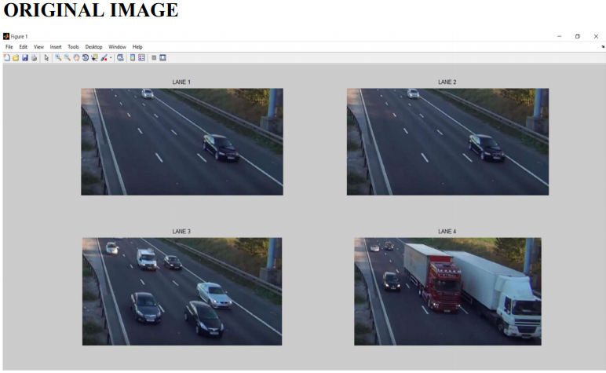
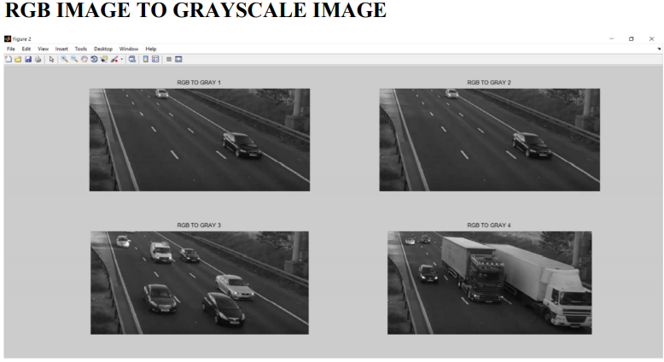
23

Slide 24
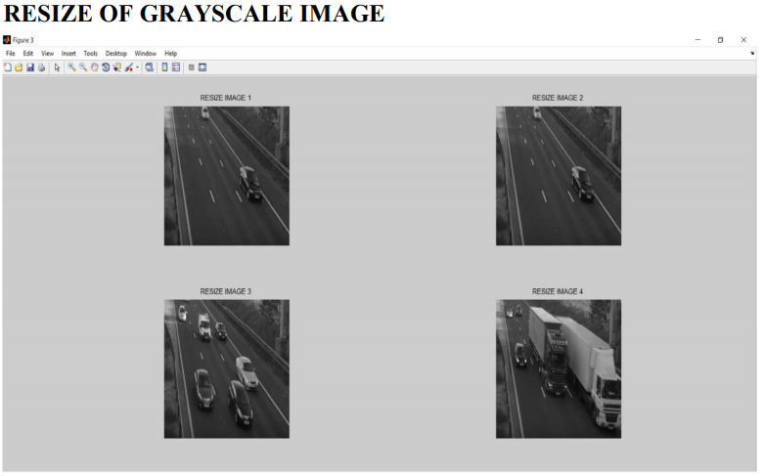
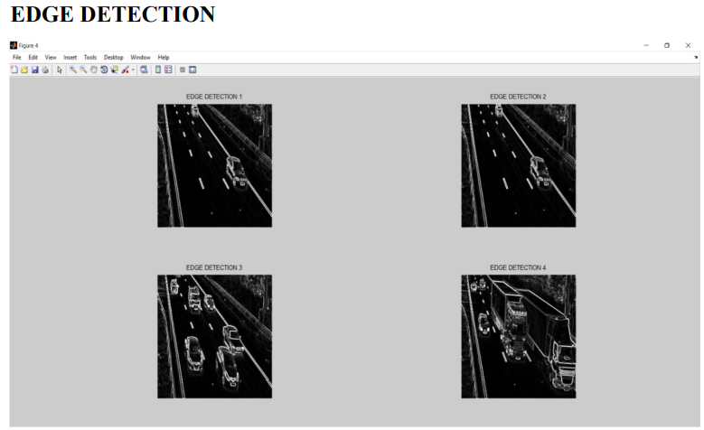

Slide 25
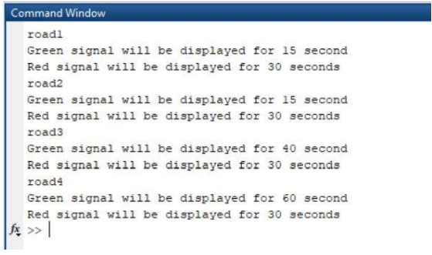
OUTPUT IMAGE OF BUSY LANE
For the considered 4 lane junction by capturing the sequence of image at the junction. We now apply the algorithm that is presented in this project in order to determine the lane whose VCD is greater when compared with the other lane.
Lane with greater VCD is allotted by greater departure period. Following image shown below is the output obtained for the considered 4 lane junction by applying the algorithm. Here lane 4 has greater VCD hence the departure period is greater.

Slide 26
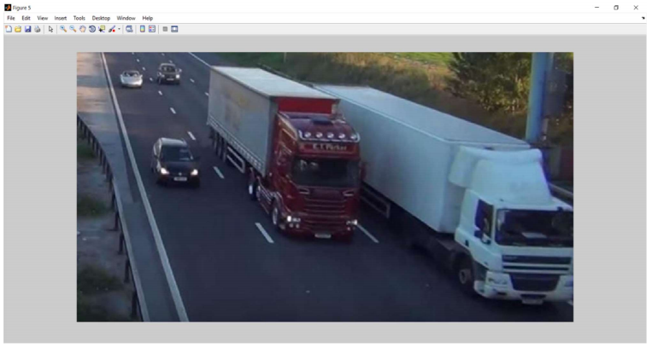
Output Image Of Busy Lane Contd..

Slide 27
CONCLUSION
An Autonomous Institution ,Affiliated to Visvesvaraya Technological University, Belagavi. Approved By AICTE, New Delhi. Recognized by UGC with 2(f) & 12(B) status. Accredited by NBA and NAAC.
27

Slide 28
Conclusion
“VCD dependent Traffic Control Signal ” technique that we propose overcomes all the limitations of the earlier (in use) techniques used for controlling the traffic.
Earlier in automatic traffic control use of timer had a drawback that the time is being wasted by green light on the empty. This technique avoids this problem.
Upon comparison of various edge detection algorithms, it was inferred that Canny Edge Detector technique is the most efficient one. The project demonstrates that image processing as a far more efficient method of traffic control as compared to traditional techniques.
The use of our technique removes the need for extra hardware such as sound sensors. The increased response time for these vehicles is crucial for the prevention of loss of life.
Major advantage is the variation in signal time which control appropriate traffic density using Image matching.
The accuracy in calculation of time due to single moving camera depends on the registration position while facing road every time. Output of our code clearly indicated some expected results. It showed matching in almost every interval that were decided as boundaries like lots of traffic, more traffic and less traffic.

Slide 29

Thank You
An Autonomous Institute
Approved by AICTE, Affiliated to VTU, Recognised by UGC with 2(f) & 12(B) status, Accredited by NBA & NAAC

